Slide 1
How to forecast solar flares?
Review of the paper “Solar Flare Prediction Using SDO/HMI Vector Magnetic Field Data with a Machine-learning Algorithm” by Bobra and Couvidat, 2015

Slide 2
Outline
Introduction
Step 0. Support Vector Machine Classifier
Step 1. Data Processing and Feature Extraction
Step 2. Definition of the Flaring and non-Flaring Classes
Step 3. Feature Selection
Step 4. Classifier Tuning and Performance Metrics
Results
Conclusion

Slide 3
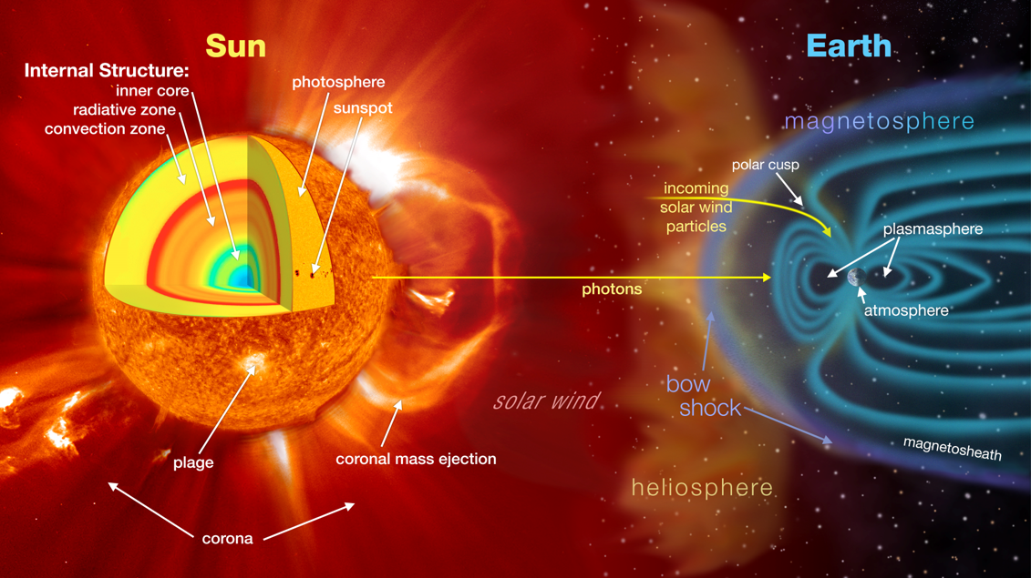
Introduction
The prediction of strong solar flares is one of the key questions of Solar Physics
Besides many attempts, the operational predictions are still mainly done based on experts’ opinion and experience

Slide 4
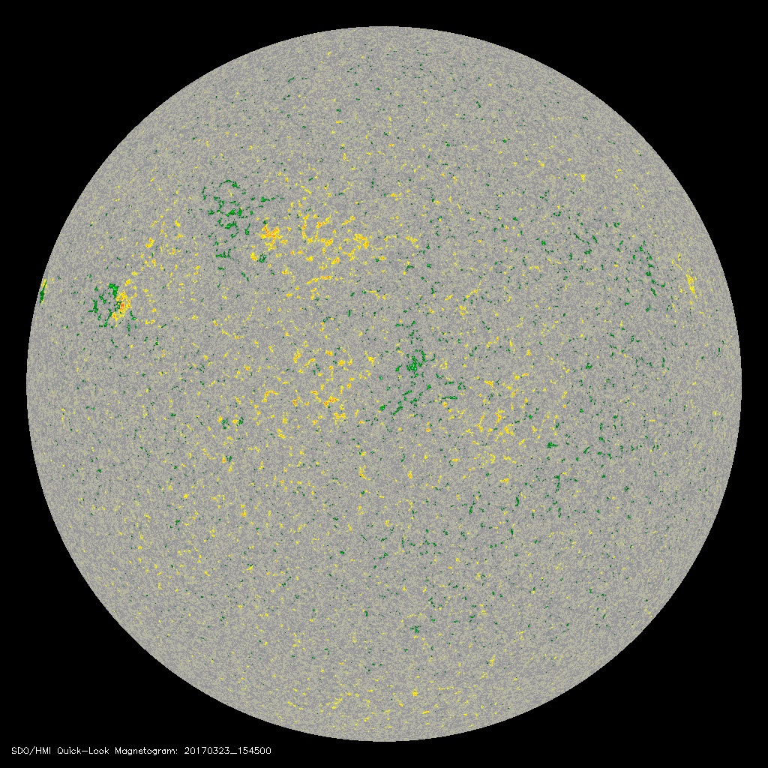
Introduction
Currently we are receiving tremendous amounts of information about the Sun and its active regions. The prediction problem is the Big Data problem.
The magnetic field represents very valuable data for the forecasts. The nonpotential magnetic field is the only reservoir to store the large energies released during the flares
The SDO/HMI provides a routine coverage of the vector magnetic field in active regions since 2010

Slide 5
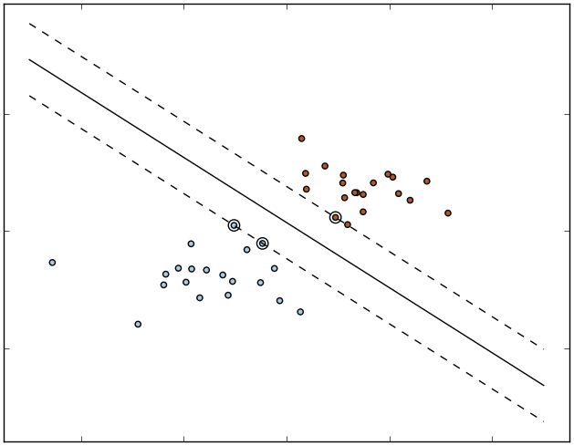
Step 0. Machine-Learning Algorithms.
Suppose we are calculating two AR features: total magnetic flux and PIL length
The calculations are done each hour for each active region
If the M1.0 class solar flare occurs within 24h after the calculation, we define the region as flaring (1), and non-flaring otherwise (0)
{Active Region} -> {(Total flux, PIL length) , flaring/non-flaring}
Flare
PIL length
No flares
Total magnetic flux

Slide 6
Step 0. Machine-Learning Algorithms.
Suppose we are calculating two AR features: total magnetic flux and PIL length
The calculations are done each hour for each active region
If the M1.0 class solar flare occurs within 24h after the calculation, we define the region as flaring (1), and non-flaring otherwise (0)
{Active Region} -> {(Total flux, PIL length) , flaring/non-flaring}
One more case {(Total flux, PIL length) , ???}
If we correctly set up the division, we can easily classify the new sample.
New case
Flare
PIL length
No flares
Total magnetic flux

Slide 7
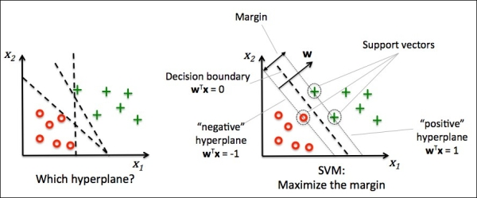
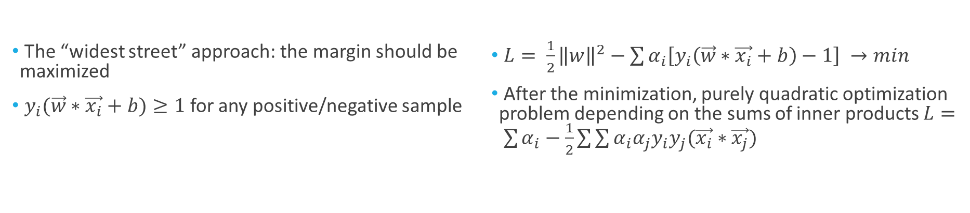
Step 0. Support Vector Machines (SVMs)
The “widest street” approach: the margin should be maximized
$y_{i}(\vec{w}∗\vec{x_{i}}+b)≥1$ for any positive/negative sample
$L= \frac{1}{2}{\left\|w\right\|}^{2}−\sum{α_{i}\left[y_{i}\left(\vec{w}∗\vec{x_{i}}+b\right)−1\right]} →min$
After the minimization, purely quadratic optimization problem depending on the sums of inner products $L= \sum{α_{i}}−\frac{1}{2}\sum{\sum{α_{i}α_{j}y_{i}y_{j}(\vec{x_{i}}∗\vec{x_{j}})}}$

Slide 8
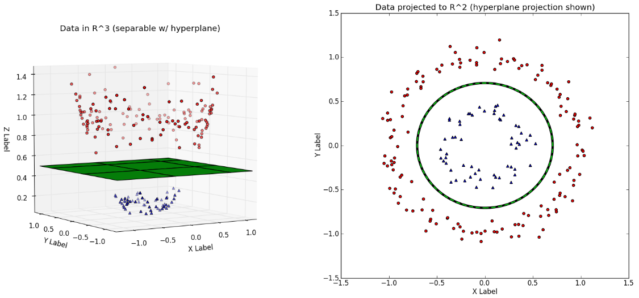
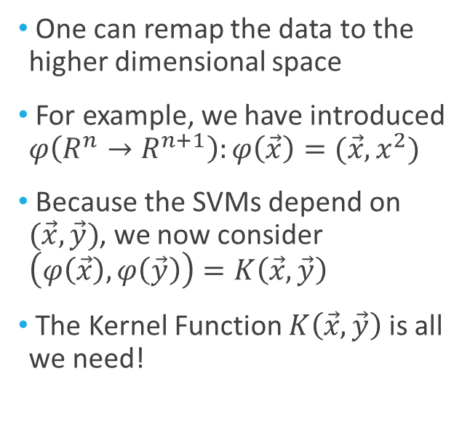
Step 0. SVMs. Kernel Trick.
One can remap the data to the higher dimensional space
For example, we have introduced $φ\left(R^{n}→R^{n+1}\right):φ\left(\vec{x}\right)=(\vec{x},x^{2})$
Because the SVMs depend on $(\vec{x},\vec{y})$, we now consider $\left(φ\left(\vec{x}\right),φ\left(\vec{y}\right)\right)=K\left(\vec{x},\vec{y}\right)$
The Kernel Function $K\left(\vec{x},\vec{y}\right)$ is all we need!

Slide 9
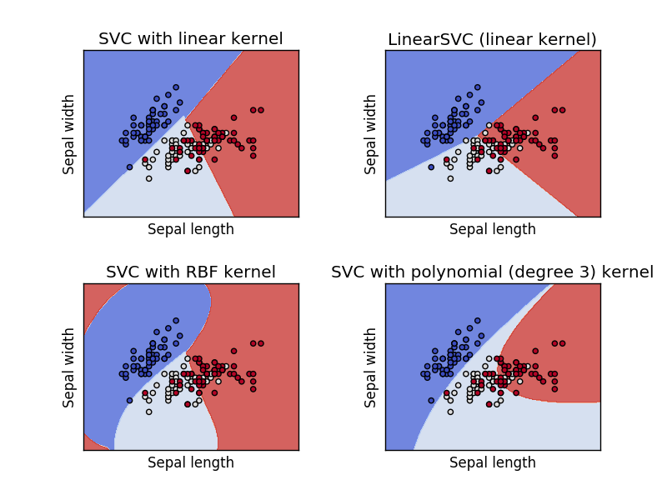
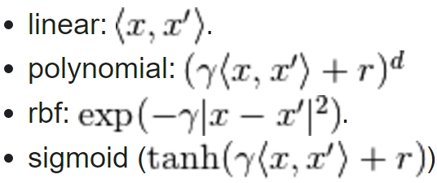
Step 0. SVMs
Different kernels are suitable for different datasets/problems
Each kernel should be tuned for the problem (has its own parameters)
Typical kernel functions:

Slide 10
Step 1. Data processing and Feature Extraction
Flare selection:
GOES class of M1.0 or higher
Location within 68^{O} from central meridian
Features of the flare <-> features of its parental active region
Features (from vector magnetograms):
Space-weather HMI Active Region Patches (SHARP) parameters
The active region is already traced with 12min time cadence

Slide 11
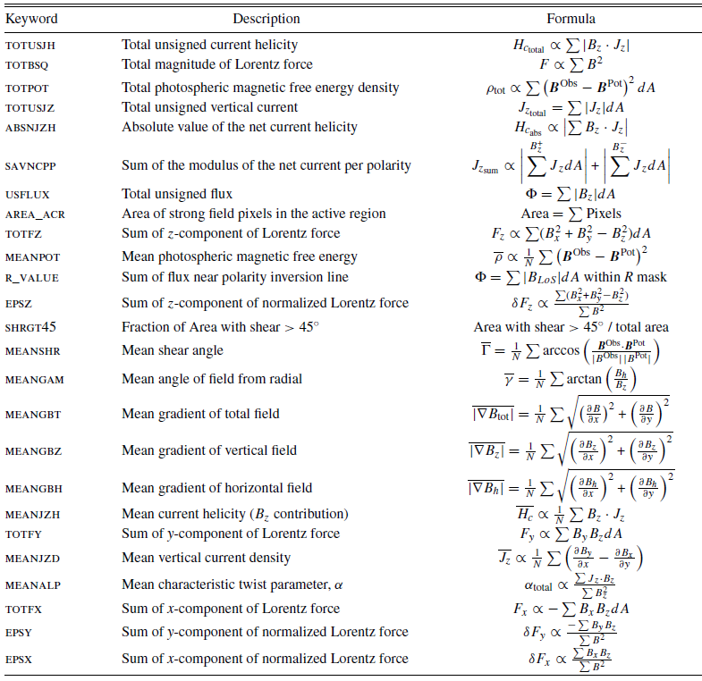
Step 1. Data processing and Feature Extraction
Parameters calculated by (B&C) for each Active Region with 12 min time cadence
Parameters (descriptors) form a vector representing the Active Region at the moment of calculation

Slide 12
Step 2. Definition of Classes
Structure of each case (active region at each time moment):
Vector of parameters/descriptors + its class (1 for potentially flaring active regions, 0 otherwise)
In (B&C), the following definitions of classes were tested:
“Operational”:
  Positive if the flare of M1.0 class or higher occurs exactly after 24h in the region after the considered time moment
  Negative if there is no M1.0 class or higher within the next 24 hours
“Segmented”:
  Positive if the flare of M1.0 class or higher occurs exactly after 24h in the region after the considered time moment
  Negative if there are no flares in the region within 48 hours before and after the considered time moments
  Total: 303 positive examples + 5000 randomly selected negative samples

Slide 13
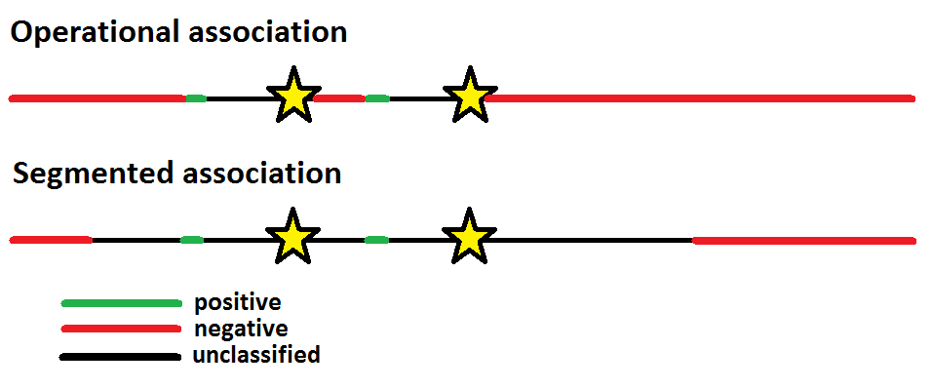
Step 2. Definition of Classes

Slide 14
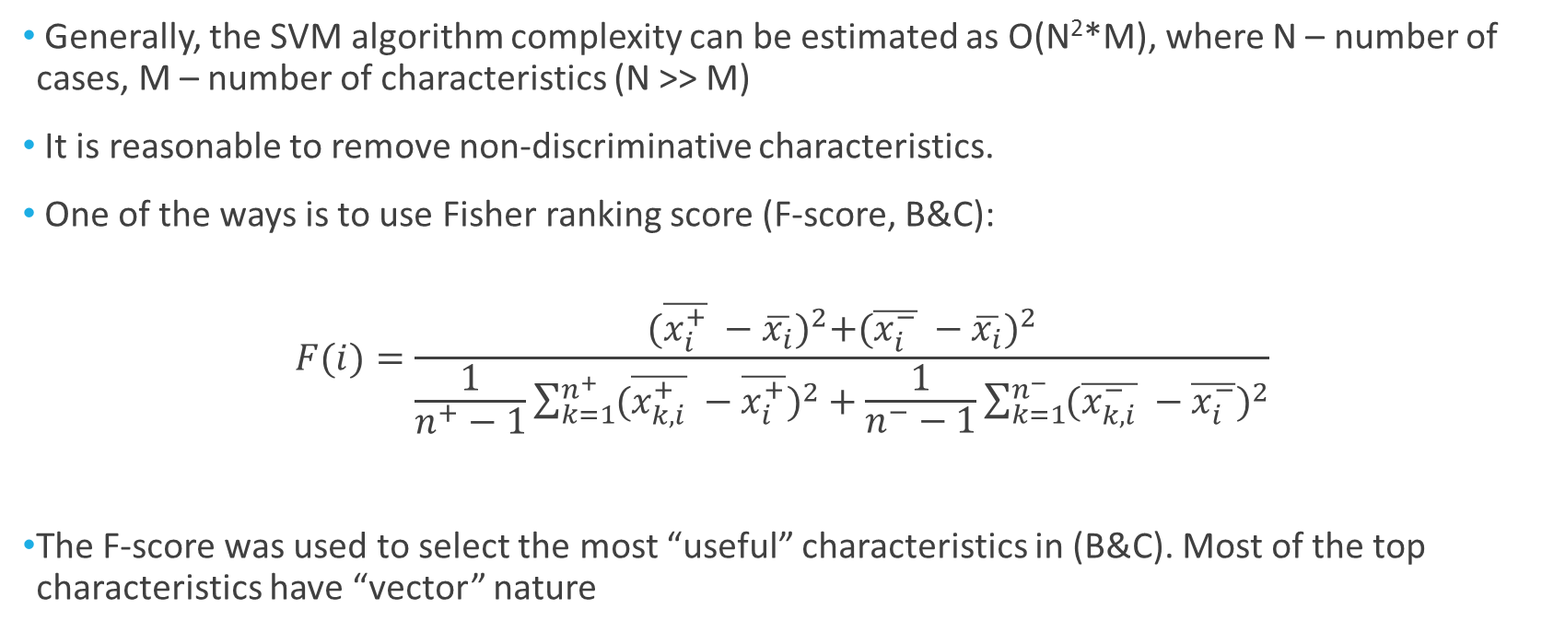
Step 3. Feature selection
Generally, the SVM algorithm complexity can be estimated as O(N²*M), where N – number of cases, M – number of characteristics (N >> M)
It is reasonable to remove non-discriminative characteristics.
One of the ways is to use Fisher ranking score (F-score, B&C):
$$F(i)=\frac{{(\overline{x_{i}^{+}} −\overline{x_{i}})}^{2}+{(\overline{x_{i}^{−}} −\overline{x_{i}})}^{2}}{\frac{1}{n^{+}−1}\sum_{k=1}^{n^{+}}{{(\overline{x_{k,i}^{+}} −\overline{x_{i}^{+}})}^{2}}+\frac{1}{n^{−}−1}\sum_{k=1}^{n^{−}}{{(\overline{x_{k,i}^{−}} −\overline{x_{i}^{−}})}^{2}}}$$
The F-score was used to select the most “useful” characteristics in (B&C). Most of the top characteristics have “vector” nature

Slide 15
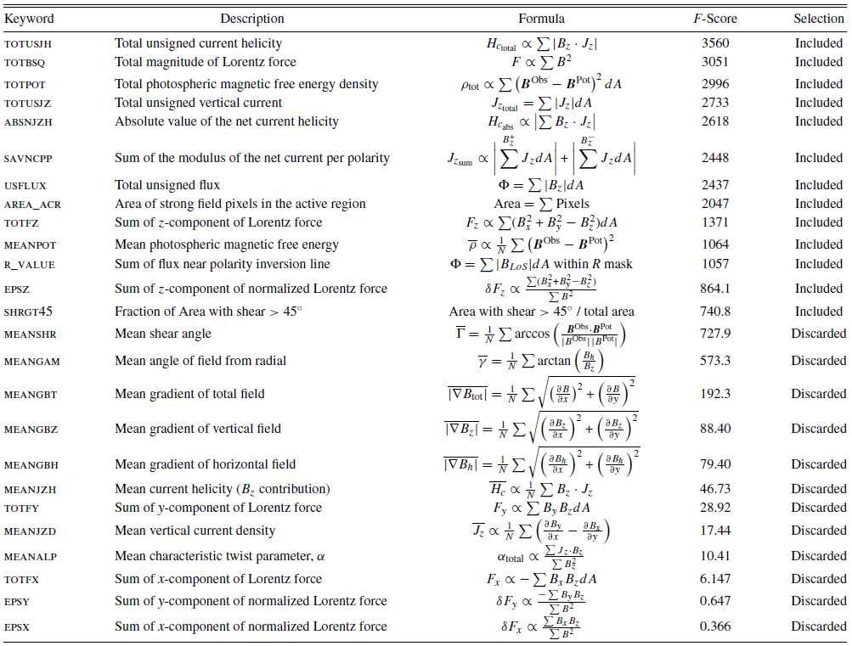
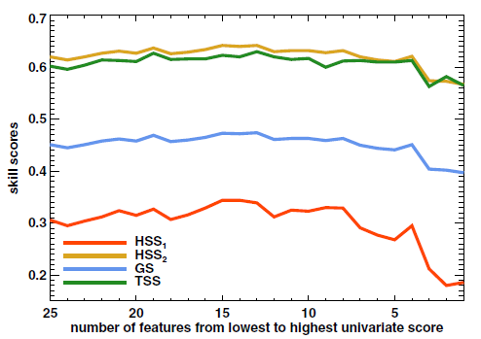

Slide 16
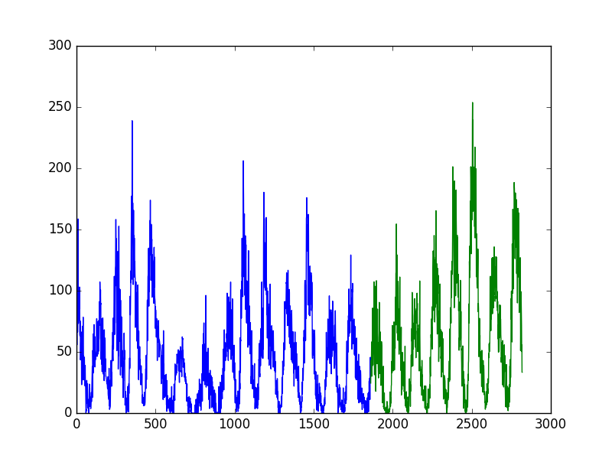
Step 4. Algorithms and performance metrics
First of all, we need to simulate the real-time data.
For such purpose, the total set of cases is divided into the training test and test set (B&C) with the approximate ratio of 70% to 30%. The question of dataset shuffling is important.
In (B&C), the totally random shuffling approach was used.
The SVM classifier with RBF kernel was used for the classification (2 parameters, weights of the classes)

Slide 17
Step 4. Performance Metrics
How to calculate the performance of the SVM classifier?
Basically, each classifier produces the following numbers:
TP – True Positives (number of positive cases predicted as positive)
TN – True Negatives (number of negative cases predicted as negative)
FP – False Positives (number of negative cases predicted as positive)
FN – False Negatives (number of positive cases predicted as negative)
Our aim is simultaneously minimize FP and FN values. The question is, how?

Slide 18
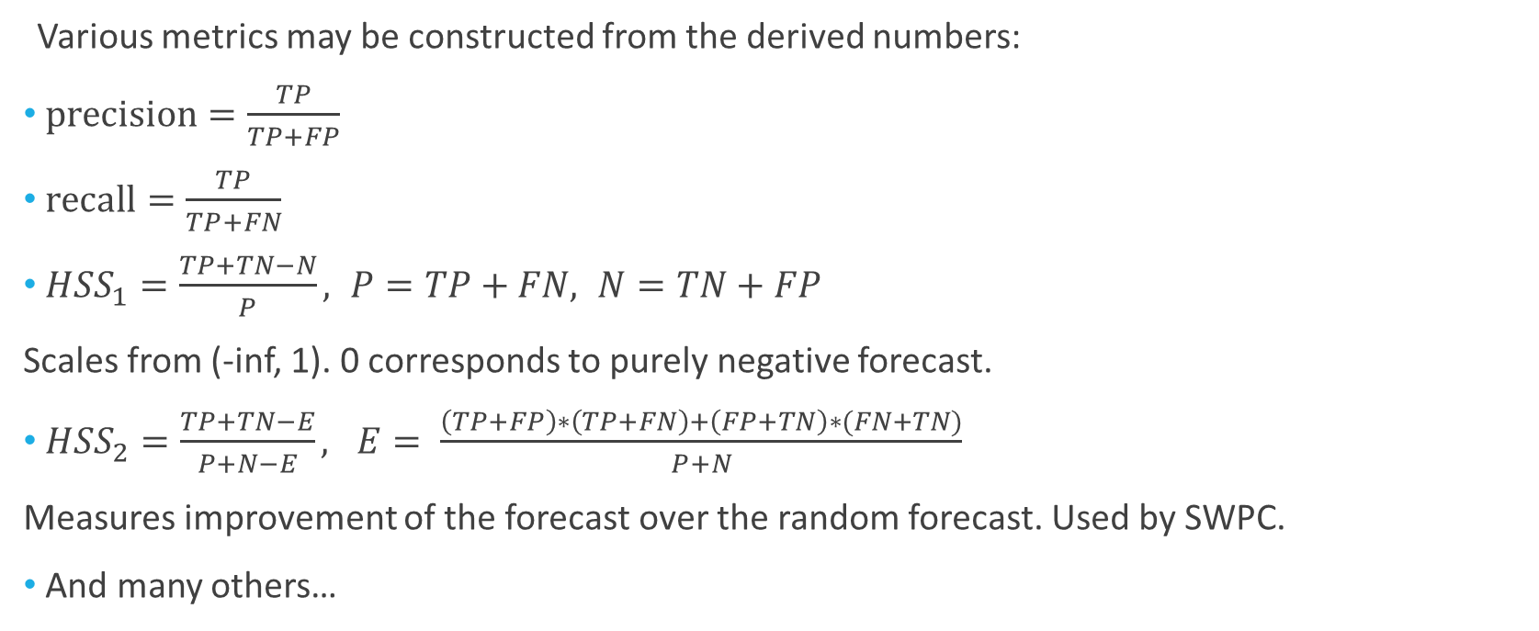
Step 4. Performance Metrics
Various metrics may be constructed from the derived numbers:
$precision=\frac{TP}{TP+FP}$
$recall=\frac{TP}{TP+FN}$
${HSS}_{1}=\frac{TP+TN−N}{P}, P=TP+FN, N=TN+FP$
Scales from (-inf, 1). 0 corresponds to purely negative forecast.
${HSS}_{2}=\frac{TP+TN−E}{P+N−E}, E= \frac{\left(TP+FP\right)∗\left(TP+FN\right)+\left(FP+TN\right)∗(FN+TN)}{P+N}$
Measures improvement of the forecast over the random forecast. Used by SWPC.
And many others…

Slide 19
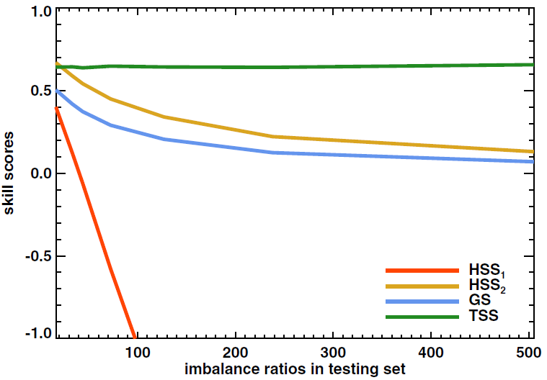
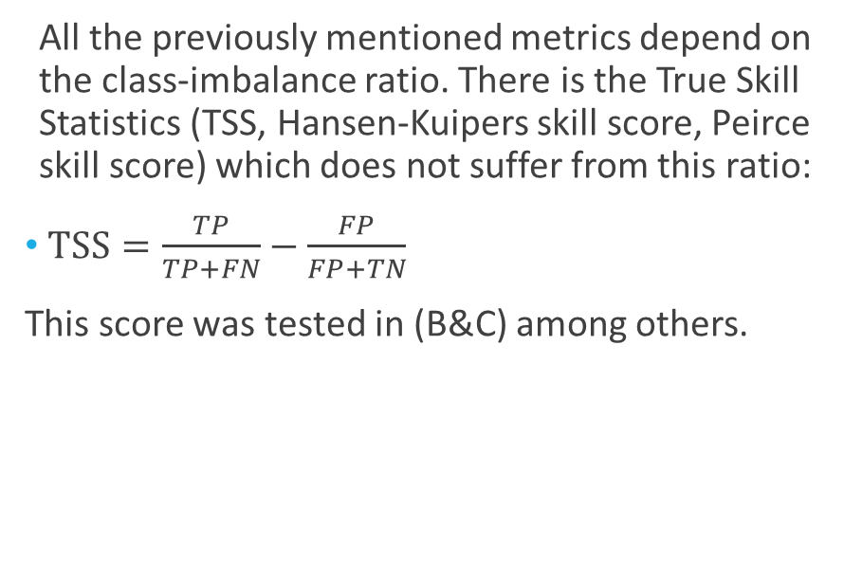
Step 4. Performance Metrics
All the previously mentioned metrics depend on the class-imbalance ratio. There is the True Skill Statistics (TSS, Hansen-Kuipers skill score, Peirce skill score) which does not suffer from this ratio:
$TSS=\frac{TP}{TP+FN}−\frac{FP}{FP+TN}$
This score was tested in (B&C) among others.

Slide 20
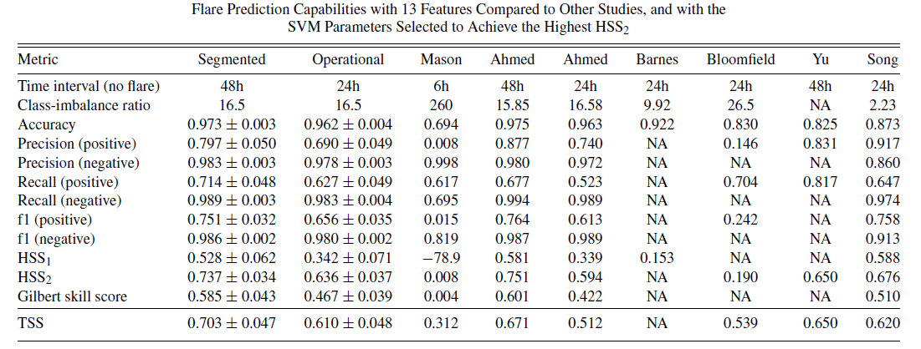
Results (B&C)

Slide 21
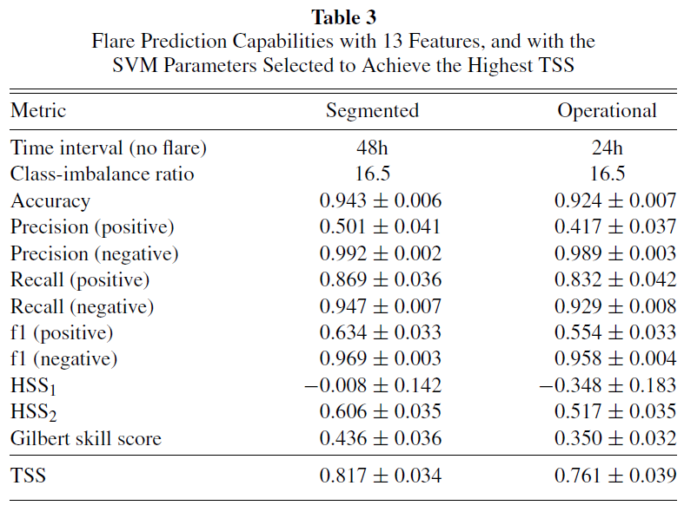
Results (B&C)
The use of HMI vector magnetograms provides a much larger database and a more uniform quality allowed by space-based observations (in comparison with previous works using ground-based observations)
The flare prediction is a strongly imbalanced problem. Calculation of TSS allows to compare different studies.
The obtained TSS are larger than in the papers studied. However, results are metrics-dependent: maximizing some scores may result in lower values for other metrics.
only the 4 parameters with the highest F-score—the total unsigned current helicity, total magnitude of the Lorentz force, total photospheric magnetic free energy density, and total unsigned vertical current—gives roughly the same TSS score as the top 13 combined.

Slide 22
In Conclusion…
Current NICT (National Institute of Information and Communications Technology) space weather forecasting center TSS scores (2000-2015, Nishizuka et al., 2017):
TSS = 0.21 for X-class flares
TSS = 0.50 for M- and X-class flares
Solar Influences Data Center of the Royal Observatory of Belgium TSS scores (2004-2012):
TSS = 0.34 for M- and X-class flares
The TSS scores obtained via Machine-Learning algorithms are significantly higher than ones based on the opinion of experts. However, the algorithms are needed to be applied accurately and tested on the real-time data.

Slide 23
Thank you for your attention!

